Slide 1


K. S. INSTITUTE OF TECHNOLOGY
An Autonomous Institution under VTU, Approved by AICTE
Accredited by NBA (CSE & ECE), NAAC with A+
No.14, Raghuvanahalli, Kanakapura Road, Bengaluru – 560109
INTERNSHIP (INDUSTRY/RESEARCH)-BINT803B
Presentation
On
ANDROID APP DEVELOPMENT USING GEN AI
By
RAKSHITA A U
1KS22CS113
Carried at
MINDMATRIX
Under the guidance of
Internal Guide External Guide
Mrs. Beena K Mr. Tirumal Mutalik
Assistant Professor, CSE, KSIT MindMatrix

Slide 2
OUTLINE
SL no. | Contents | SLIDE no.
1 | About the Organization | 3
2 | Objectives of the Internship | 4
3 | Learning experiences Trainings learned Technical knowledge gained (include any learning experinces if any EXTRA SLIDES) Project assigned | 5-7
4 | Methodology Block diagram Approaches explored Flow chart | 8-9
5 | Hardware /Software details | 10
6 | Result analysis(include any diagrams or analysis if any) | 11-12
7 | Learning Outcomes | 13
8 | Conclusion and future scope | 14

Slide 3
About the Organization
MindMatrix is a technology company that provides practical training in Android Development, Artificial Intelligence, Machine Learning, and Cloud Computing through industry-oriented internships.
The internship environment encouraged innovation, teamwork, and hands-on learning through real-time projects and milestone-based activities.
It helped improve technical knowledge, problem-solving abilities, debugging skills, and understanding of Android development workflows, preparing students for future careers in software development and AI technologies.
The vision of MindMatrix is to create a learning ecosystem where quality education is accessible, practical, and aligned with the needs of the modern technology industry.

Slide 4
OBJECTIVES OF THE INTERNSHIP
To develop Android application development skills using Kotlin.
To learn Firebase Authentication and Realtime Database integration.
To gain practical exposure to industry workflows.
To improve problem-solving and debugging abilities.
To enhance communication and teamwork skills.
To become industry-ready in Android and AI-based technologies.
To bridge the gap between academic learning and industry requirements.
To provide practical exposure through project-based learning and mentorship.

Slide 5
LEARNING EXPERIENCES
TRAININGS LEARNED
Debugging Android Studio errors.
Emulator setup and testing.
Firebase database handling.
Android project structure understanding.
Implemented product listing, shopping cart, and checkout modules using activity-based Android navigation.
Explored Firebase Firestore integration and real-time order management for e-commerce functionality.
Developed user-friendly UI/UX screens for artisans and customers to improve product browsing and shopping experience.

Slide 6
LEARNING EXPERIENCES
TECHNICAL KNOWLEDGE GAINED
Explored Firebase Firestore and Firebase Storage integration.
Learned Prompt Engineering and Generative AI concepts.
Developed UI/UX design skills using XML layouts.
Improved debugging and Android Studio troubleshooting skills.
Understood real-time application workflows and Firebase synchronization.
Learned Android Development using Kotlin.
Gained exposure to analytics visualization using MPAndroidChart.
Improved understanding of scalable Android application architecture.

Slide 7
LEARNING EXPERIENCES
PROJECT ASSIGNED & APPROACHES EXPLORED
Hasta-Kala Shop
Android E-Commerce Application for Indian Artisans
Hasta-Kala Shop is an Android-based e-commerce application designed for Indian artisans and handcrafted product sellers. The application allows artisans to showcase products and enables customers to browse, purchase, and track handcrafted items digitally.
Approaches Explored
E-Commerce Workflow Design
User-friendly UI/UX Design
Analytics Visualization using Charts
Modular Android Architecture

Slide 8
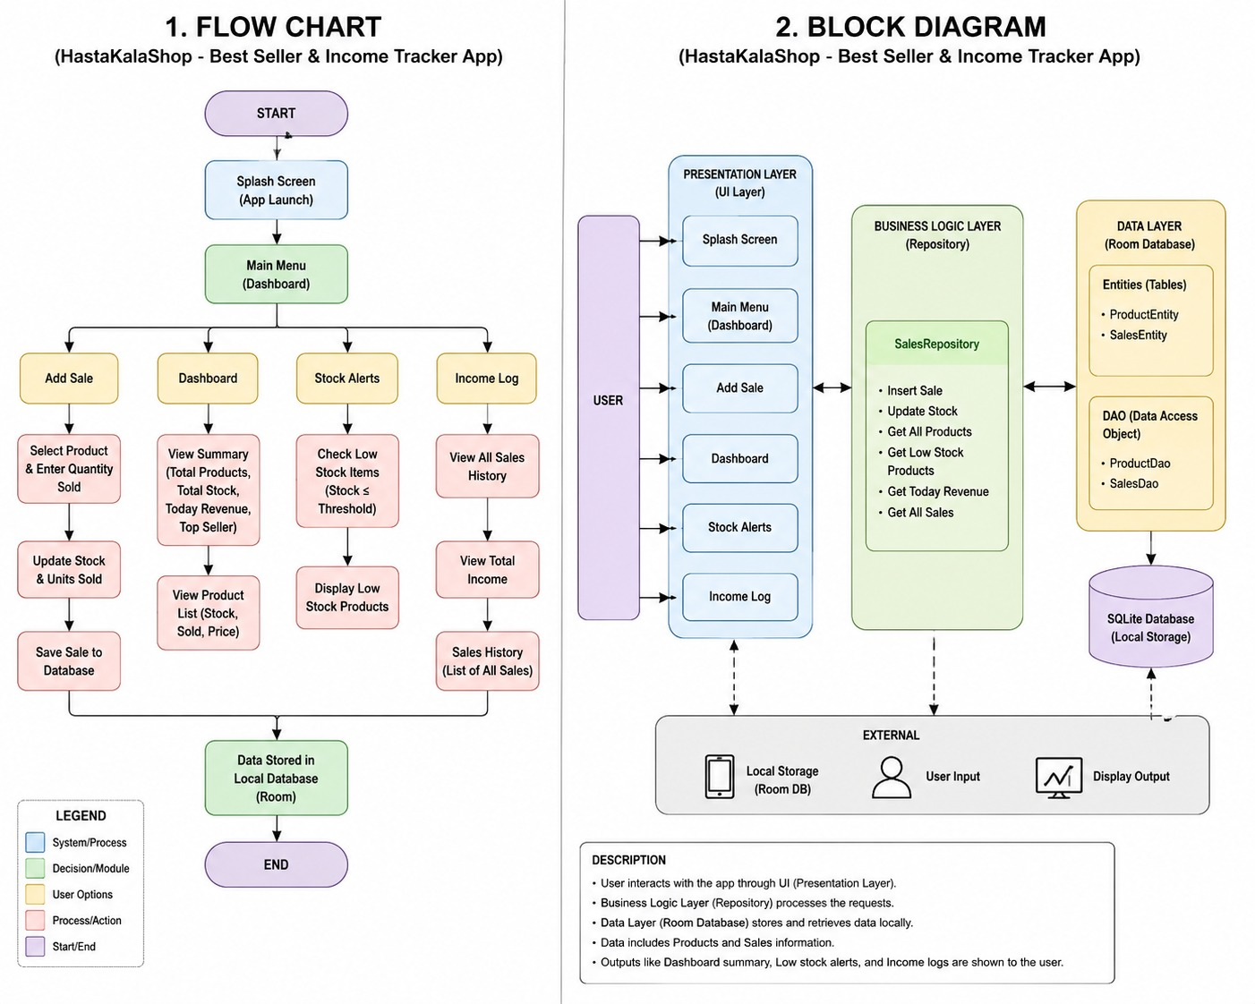
METHODOLOGY
BLOCK DIAGRAM

Slide 9
METHODOLOGY
FLOW CHART

Slide 10
HARDWARE/SOFTWARE DETAILS
Hardware Requirements
Android Smartphone / Android Emulator
Stable Internet Connection
Software Requirements
Android Studio
Kotlin Programming Language
Firebase Firestore
Firebase Storage
Firebase Authentication
Android SDK

Slide 11
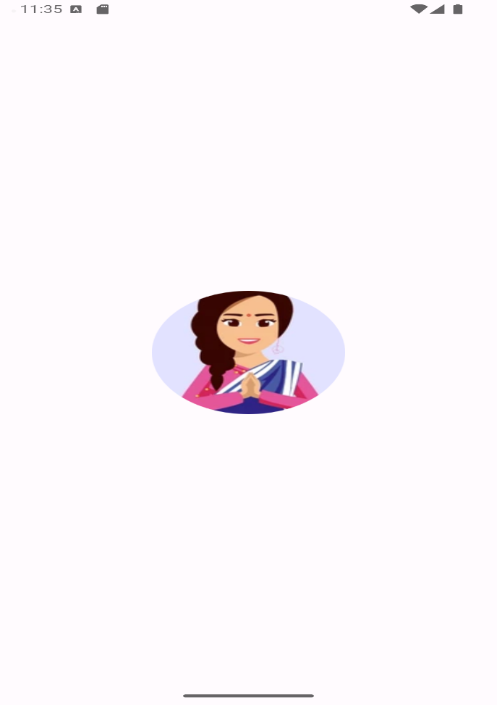

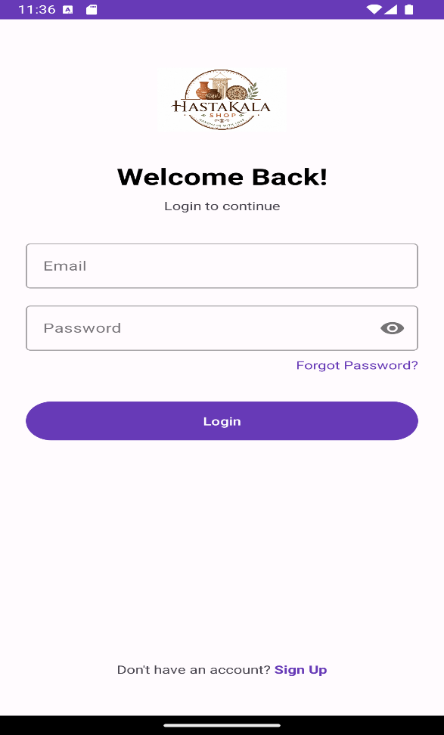
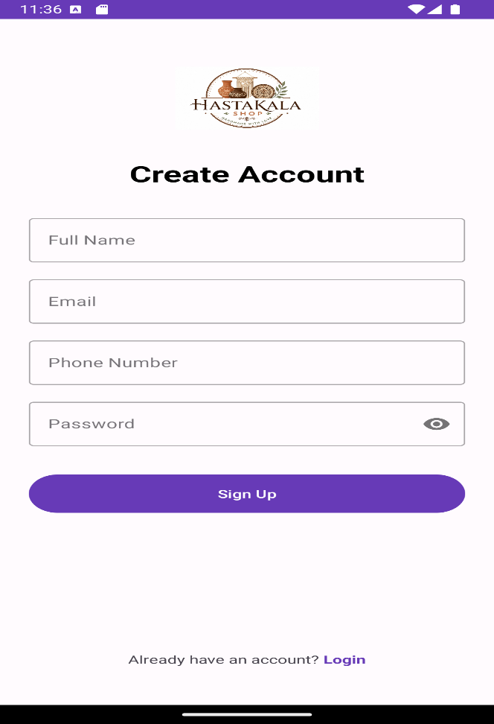
RESULTS

Slide 12
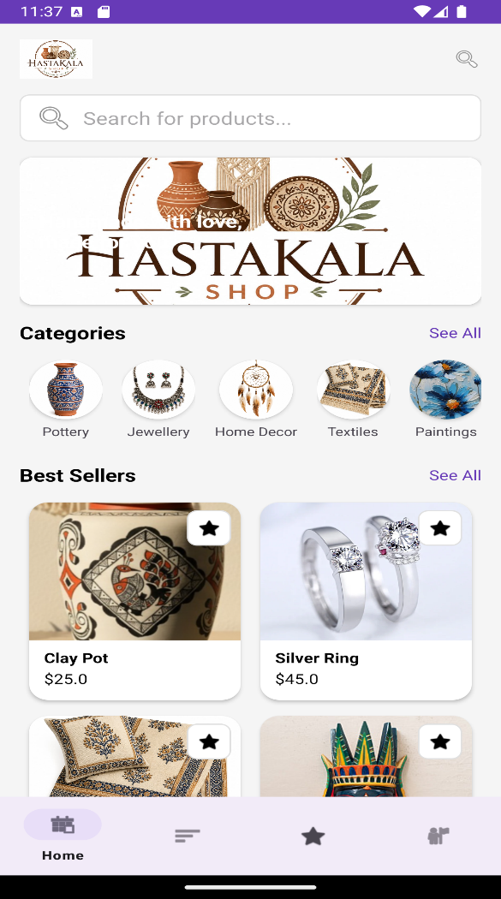
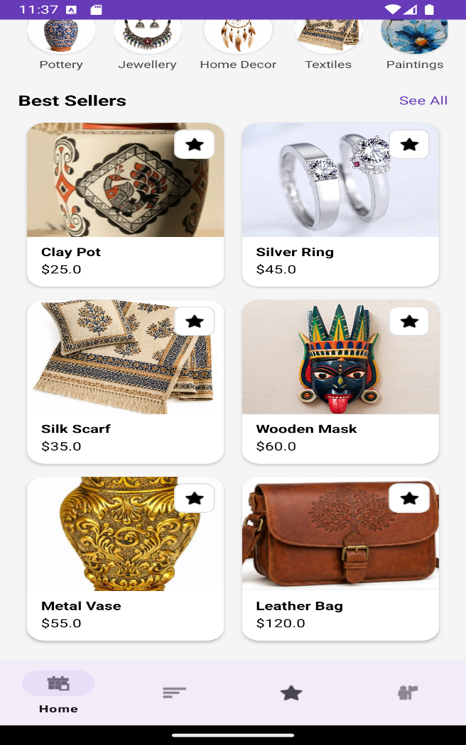
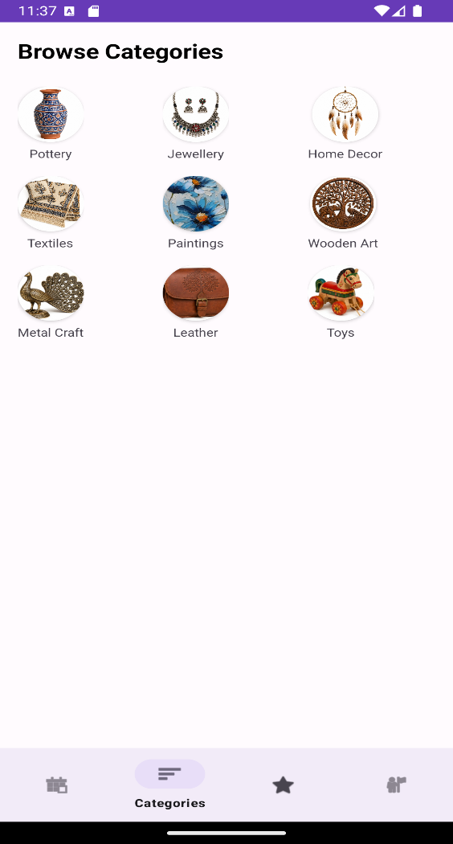
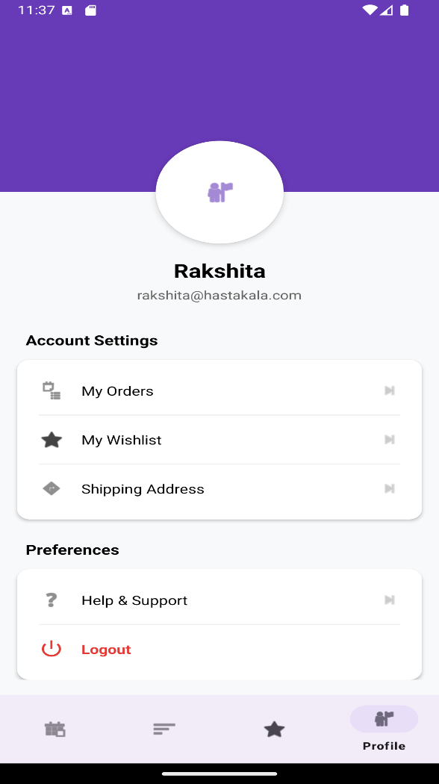
RESULTS

Slide 13
LEARNING OUTCOMES
Enhanced adaptability toward learning new technologies and frameworks.
Gained practical experience in Android application development using Kotlin.
Learned Firebase Firestore, Firebase Storage, and Authentication integration.
Enhanced debugging, problem-solving, and analytical thinking skills.
Developed real-world e-commerce project implementation experience.
Learned industry-oriented software development practices and workflows.
Increased confidence in handling complete end-to-end Android projects

Slide 14
CONCLUSION & FUTURE SCOPE
Conclusion
The internship at MindMatrix provided valuable practical exposure to Android development and Generative AI concepts through the development of the Hasta-Kala Shop application. The project helped improve technical knowledge in Kotlin, Firebase integration, UI/UX design, and real-time database management.
Future Scope
AI-based product recommendation system
Online payment gateway integration
Push notification support Multi-language application support
Live order tracking functionality
Enhanced admin management features
AI-powered customer assistance chatbot

Slide 15
Thank you

